Slide 1
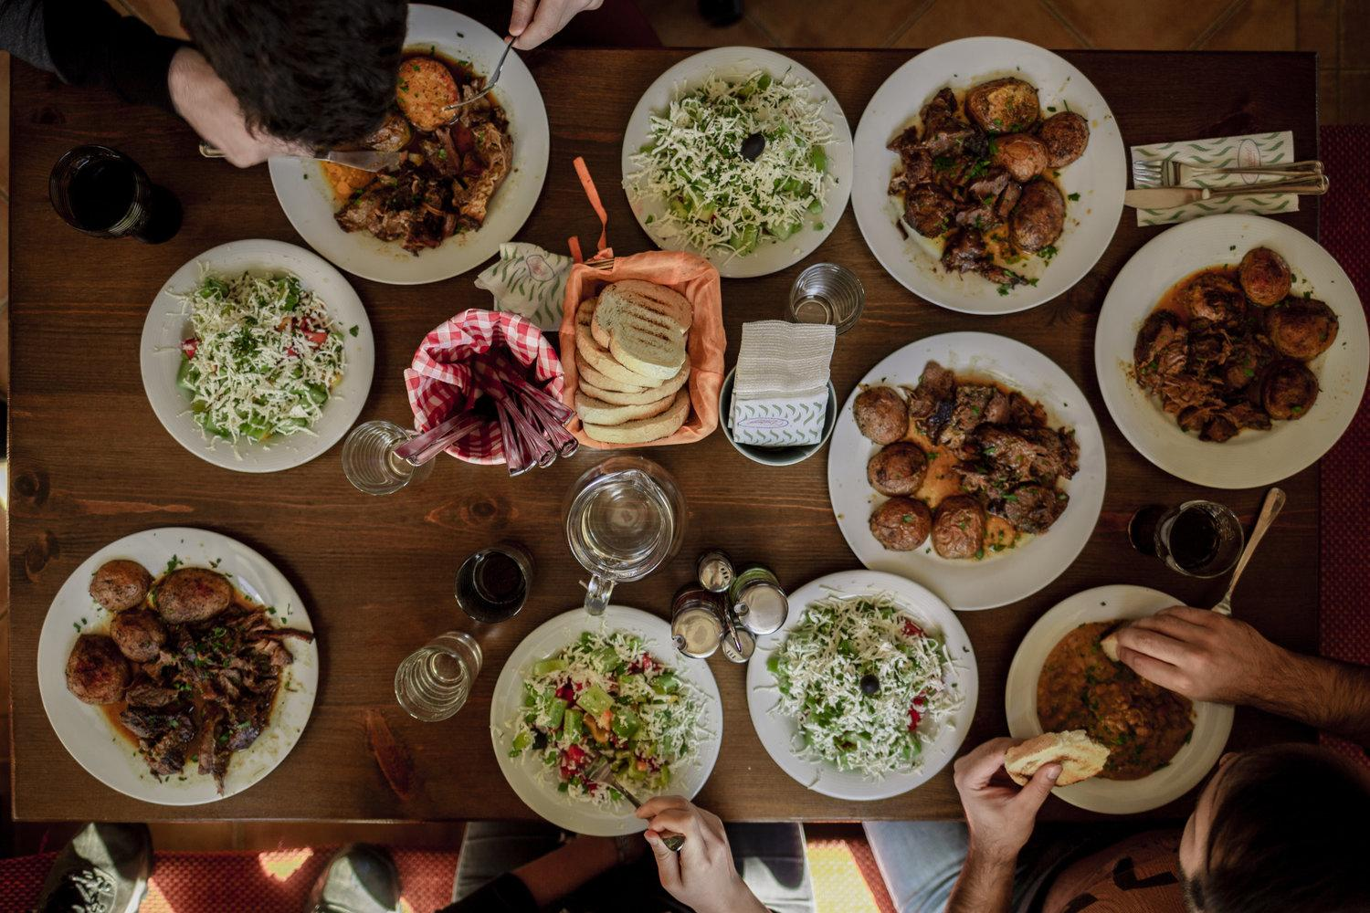
Zomato Project
By Ankit Singh
DS May 2024 Batch

Slide 2


About Zomato:-
Zomato is a leading restaurant search and discovery platform founded in 2008 in India. It allows users to find restaurants, read reviews, and order food for delivery. Zomato is a pioneer in the Indian market and now operates globally with over 1 million listed restaurants across 24 countries.
It has received hundreds of millions in funding from investors and has grown through acquiring other food-related companies

Slide 3

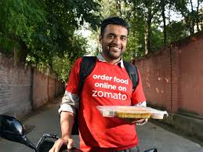
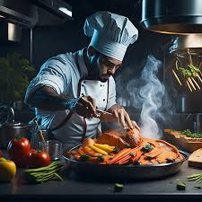
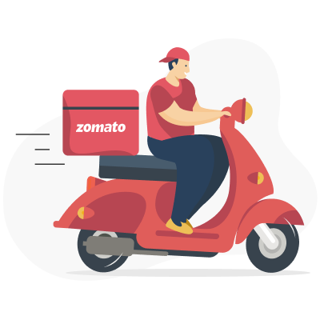
How ZOMATO Works
STEP 1:
Order food from Zomato app.
STEP 4:
STEP 2:
The delivery partner reaches the customers location and delivers the order.
Restaurant accepts the order then prepare & pack the order.
STEP 3:
The delivery partner picks up the order from the restaurant.

Slide 4


Problem Statement
You are hired as a consultant data analyst by Zomato where the team is looking for expansion and opening more restaurants. Your task is to develop strategies/suggestions for opening newer restaurants.

Slide 5

Data Overview
Total number of Restaurants: 9,551 restaurants in various countries and cities.
Geographical Coverage : 15 Countries across the globe serving different types of food to different types of customers.
Number of Cities : 141 Cities in various Countries from different social backgrounds.
Number of Cuisines : 1826 Cuisines in 9,551 Restaurants in 15 different Countries.
Additional information about the Restaurants such as Has Table booking, Has Online delivery, Is Delivering now, Switch to Order menu.

Slide 6

Analytical Approach and Tools
Data Cleaning
Data Enrichment
Descriptive Analysis
Suggestions
Visualization
Used functions like Remove Duplicates, Find and Replace, TRIM to ensure data accuracy so that becomes usable and suitable to work on.
Enhanced the data set with additional column like Country using VLOOKUP function with reference from additional table present in country description.
Employed Pivot tables for summarizing, aggregating key metrics for analysing patterns across different countries and cuisines types.
Based on location and preferences came up with some suggestions for future.Based on location and preferences came up with some suggestions for future.
Created dynamic charts and dashboard for representing data and enabling interaction with data which will help us get various insights from the data.

Slide 7
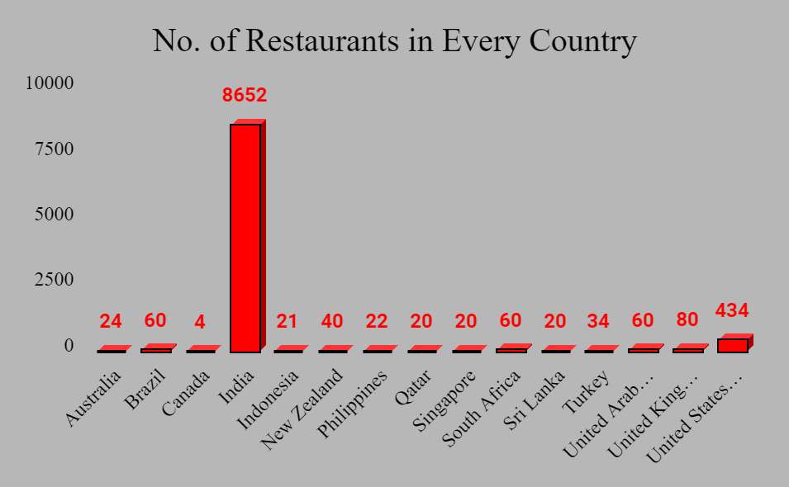
Total 9551 Restaurants in 15 Countries
Highest Number of Restaurants in India.

Slide 8

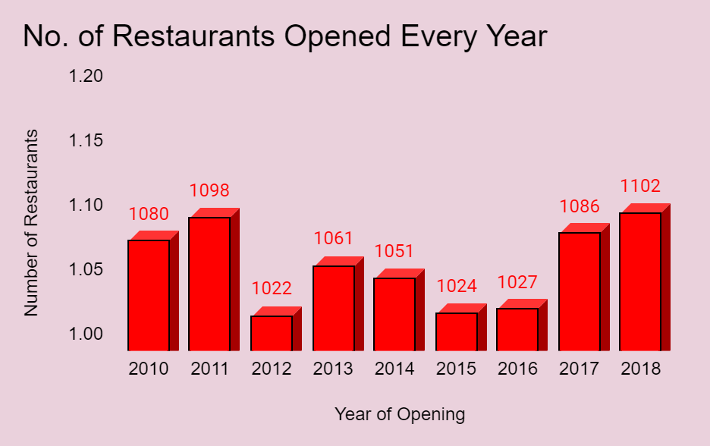
No. of Restaurants Opened Every Year
Highest no. of Restaurants opened in 2018.
Least no. of Restaurants opened in 2012.

Slide 9
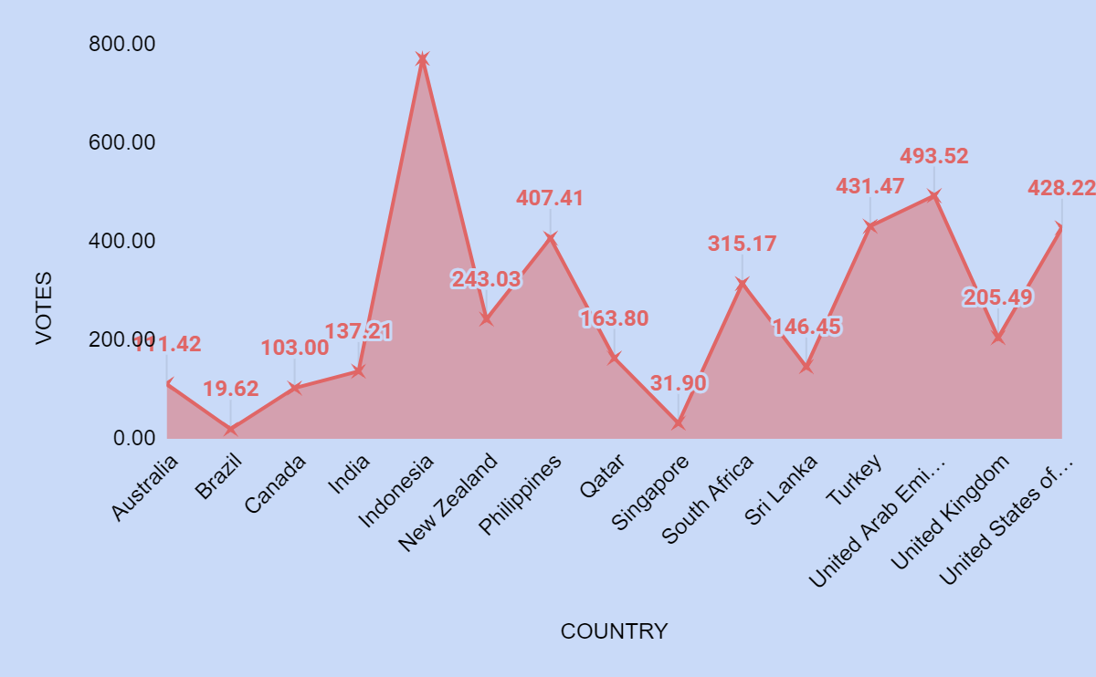
Average Votes In Every Country
Highest Votes in Indonesia indicating people are liking the restaurants.
Lowest Votes in Brazil indicating that people there are not so fond of restaurants there.

Slide 10

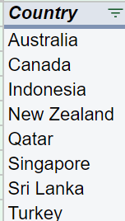
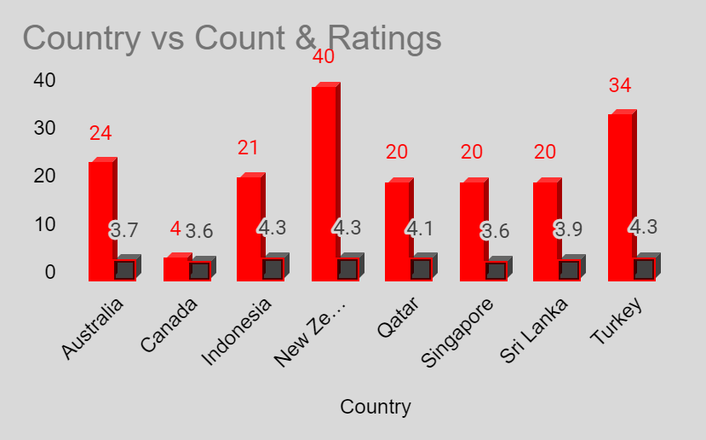
Suggested Countires for Opening New Restaurants
8 Countries are suggested for opening new restaurants having existing number of restaurants less than 40 and average ratings less than 4.5 .

Slide 11

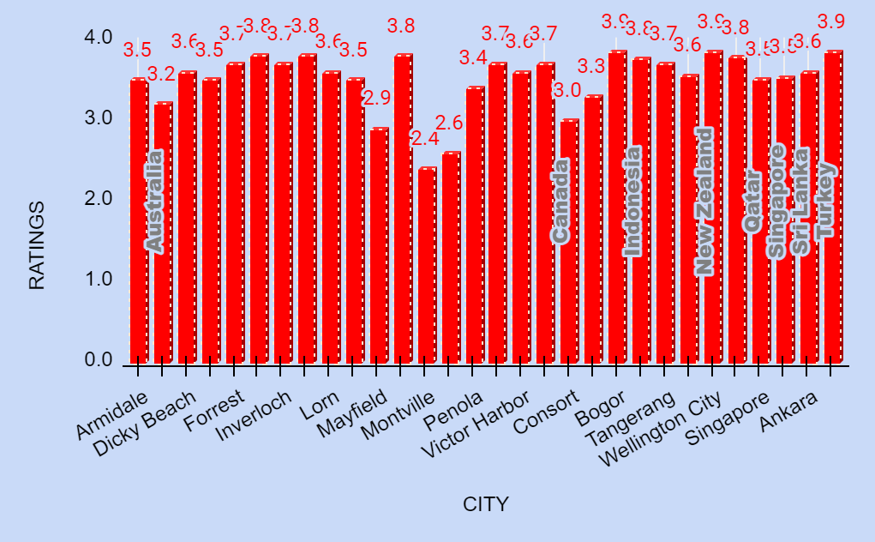
Suggested Cities
After analyzing the data these cities in suggested countries were found to be suitable for opening new restaurants.
These cities have less competition and the average rating of restaurant present there are also from medium brackets.
New business will not struggle to survive here because of low competitors and their average performance.

Slide 12


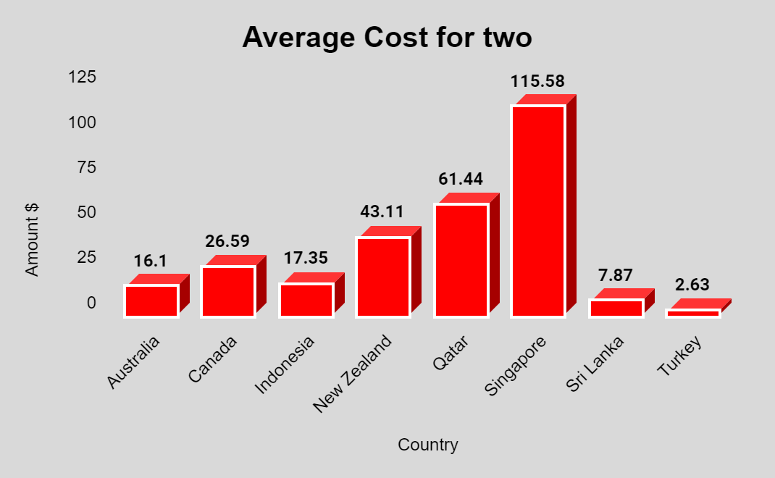
Average Cost For two in Suggested Countries
Average COst for two in Turkey is lowest and highest in Singapore.
Different average cost in different countries show difference in economic conditions in various countries.
New restaurants should serve food according to these average cost only in order to survive the competition.

Slide 13
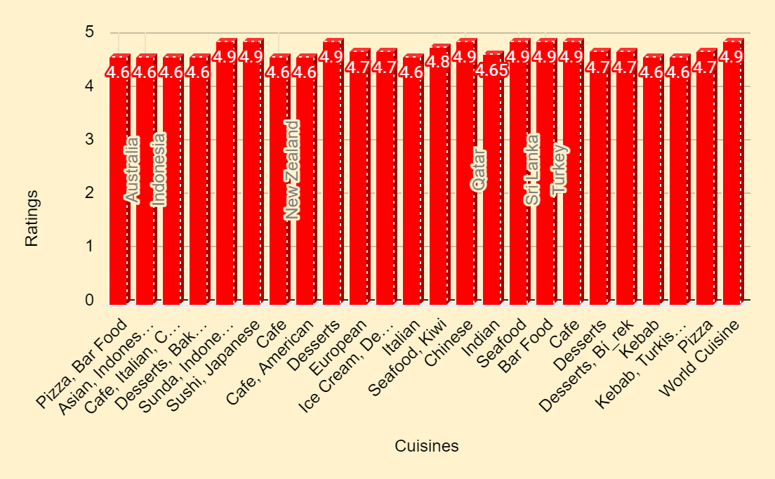

Cuisines which are Highly Preferred
These cuisines have the highest ratings making them popular among the local people.
These Cuisines would be best for the new restaurants for competing in the market.

Slide 14
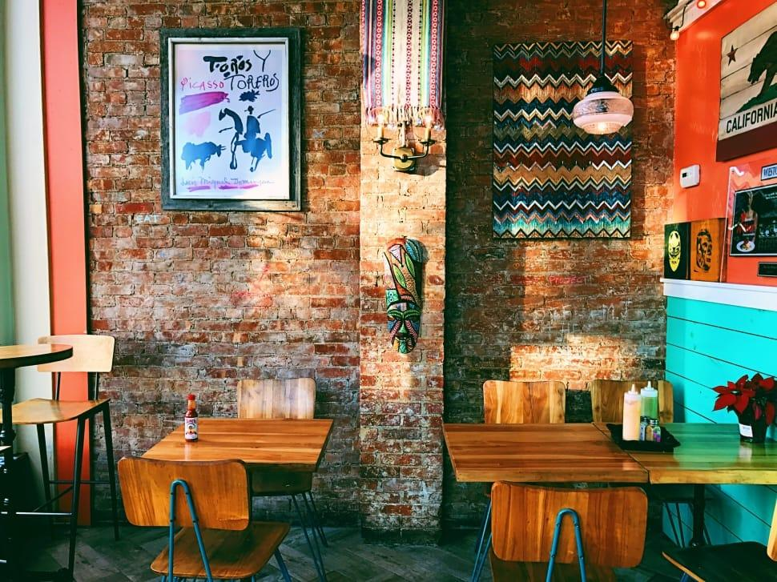

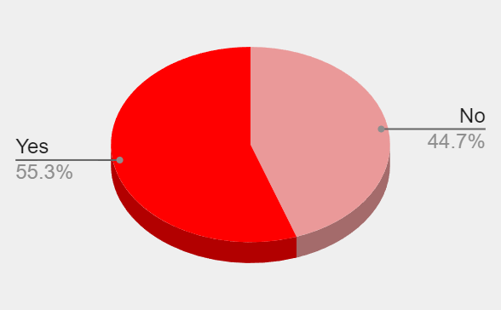
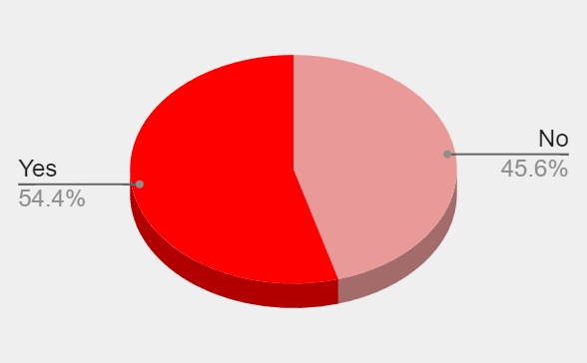
HHas Table Booking
Has Online Delivery
Restaurants which have table bookings have higher ratings than restaurants who don’t.
New restaurants should offer table bookings for better customer satisfaction.
Restaurants having online delivery facility have higher average ratings than others.
So new establishment should aslo offer this facility.

Slide 15
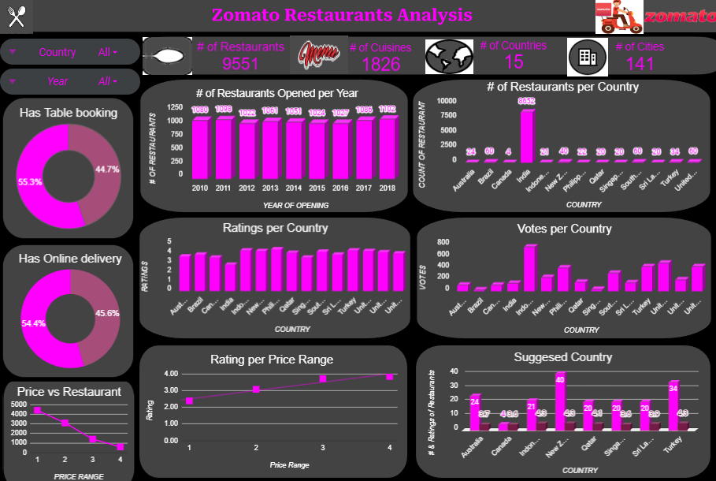
DASHBOARD

Slide 16


CONCLUSION
Conclusion and Key Insights
Australia, Canada, Indonesia, New Zealand, Qatar, Sri Lanka, Singapore and Turkey are the potential locations where new establishments can be made.
India can also be looked upon for opening restaurants as it has scope for profit but it will require more complex strategies as there is very high competition.
Choice of Cuisines will have most of the impact in gaining success.
In Order to survive neck through competition and stand out from the crowd we would have to focus more on Ambience, dining experience and quality of food.
The Price range must be adjusted according to the cuisines and location.

Slide 17




